Slide 1
Lifecycle Hooks, Routing and Navigation
Priyanka Sarode
April-2022

Slide 2
Lifecycle Hooks OnInit interface OnInit and OnDestroy OnChanges Constructor vs ngOnInit Routing and Navigation New and faster view engine Importing RouterModule Creating Routes Path and Components Exporting Routes Passing Route parameters ActivatedRoute Params.snapshot ParamsMap Subscribing parameters Passing multiple parameters RouterOutlet using <router-outlet> RouterLink using [routerLink] Defining child routes Dynamic components with NgComponentOutlet

Slide 3
Lifecycle hooks
In Angular, a component instance has a lifecycle that begins when Angular instantiates the component class and renders the component view and its child views.
The lifecycle continues with change detection, in which Angular detects changes in data-bound properties and updates both the view and the component instance as needed.
When Angular destroys the component instance and removes its rendered template from the DOM, the lifecycle is complete.
Directives have a similar lifecycle to instances, which Angular creates, updates, and destroys during execution.
Angular applications can use lifecycle hook methods to intercept key events in a component’s or directive’s lifecycle in order to initialize new instances, initiate change detection when necessary, respond to updates during change detection, and clean up before deleting instances.

Slide 4
Hook methods are called by Angular in the following order:
Sr.no. | HOOK METHOD | DETAILS
1 | ngOnChanges | When an input or output binding value changes.
2 | ngOnInit | After the first ngOnChanges.
3 | ngDoCheck | Developer's custom change detection.
4 | ngAfterContentInit | After component content initialized.
5 | ngAfterContentChecked | After every check of component content.
6 | ngAfterViewInit | After the views of a component are initialized.
7 | ngAfterViewChecked | After every check of the views of a component.
8 | ngOnDestroy | Just before the directive is destroyed.

Slide 5
Practical Demo
Project Name : LifecycleHookDemo

Slide 6
Hook Methods in detail
1. ngOnChanges
This method is called once when a component is created and then every time one of the component’s input properties changes. As a parameter, it receives a SimpleChanges object, which contains information about which of the input properties has changed — if more than one — as well as its current and previous values.
It should be noted that if your component has no inputs or if you use it without any inputs, the framework will not call ngOnChanges()
This is one of the lifecycle hooks that can be useful in a variety of situations. It comes in handy when you need to handle any specific logic in the component based on the received input property.

Slide 7
Hook Methods in detail
2. ngOnInit
This method is only called once during the component’s lifecycle, following the first ngOnChanges call. When there are no template-bound inputs, ngOnInit is still called even if ngOnChanges is not.
In Angular, this is one of the most commonly used lifecycle hooks. This is where you can make server requests to load content, create a FormGroup for a form to be handled by that component, set subscriptions, and much more. It’s where you can do any initializations right after the component is built. Even, whenever we create a new component using Angular CLI, ngOnInit is the only hook that will already be available to use by default.

Slide 8
Hook Methods in detail
2. ngOnInit
The constructor()
When the class is instantiated, the default method, i.e., constructor() is called, which ensures that all fields in the class and its subclasses are properly initialized.
n Angular, the Dependency Injector (DI) analyses the constructor parameters, and when it creates a new instance by calling new MyClass() it looks for providers that match the types of the constructor parameters, resolves them, and passes them to the constructor.
Should only be used to initialize class members and should not be used to perform actual work. Because the constructor() is called before ngOnInit the component hasn’t yet been created; only the component class has been instantiated, so the dependencies are brought in, but the initialization code will not run.

Slide 9
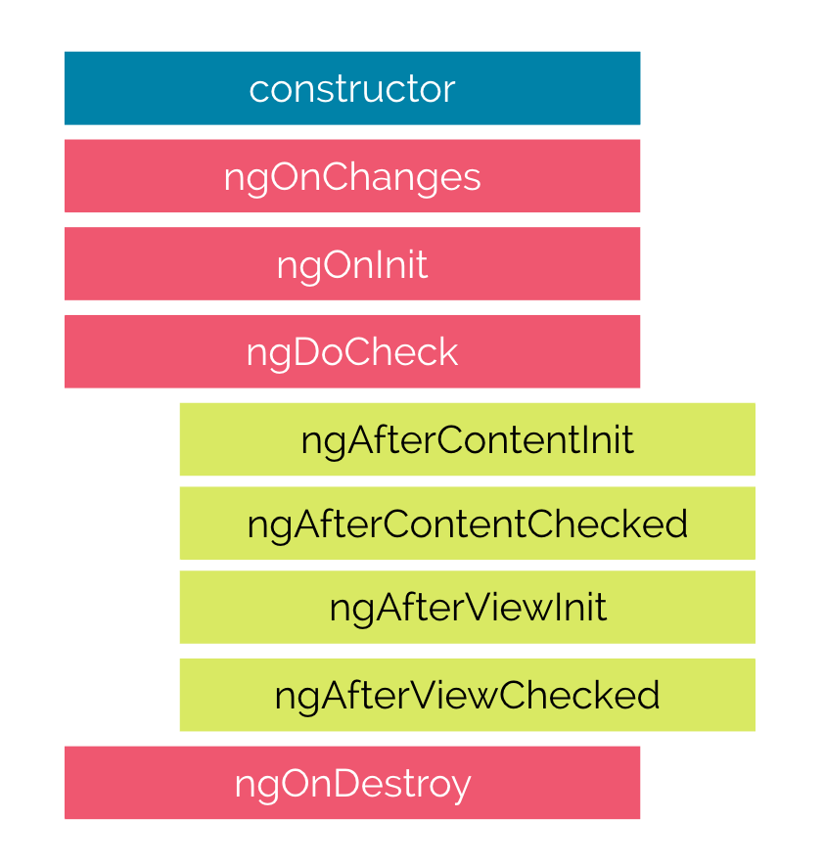
Hook Methods in detail
2. ngOnInit
This is a life cycle hook called by Angular to indicate that the component has been completed.
All initialization/declaration should be done with this method. Because the component will be initialized at this point.

Slide 10
Hook Methods in detail
3. ngDoCheck
This hook can be thought of as an extension of the ngOnChanges hook.
This method can be used to detect changes that Angular cannot or will not detect.
It is called after the ngOnChanges and ngOnInit hooks in every change detection.
This hook is expensive because it is called so frequently; after every change detection cycle,
regardless of where the change occurred. As a result, it should be used with caution so that it does not negatively impact the user experience.
Well, because Angular tracks object references, if we mutate the object without changing the reference, Angular will not detect the changes and will not run change detection for the component. As a result, the new name property value will not be rendered in DOM again. Fortunately, we can check for object mutations and notify Angular using the ngDoCheck.

Slide 11
Hook Methods in detail
4. ngAfterContentInit
This method is called only once during the component’s lifecycle. Within this hook, we have access to the ElementRef of the ContentChild for the first time after the component is created; that is after Angular has already projected the external content into the component’s view.
5. ngAfterContentChecked
This method is invoked once during the component’s lifecycle, following ngAfterContentInit, and then after each subsequent ngDoCheck.
After Angular has checked the content projected into the component in the current digest loop, it is called.

Slide 12
Hook Methods in detail
6. ngAfterViewInit
This method is only called once during the component’s lifecycle, immediately after ngAfterContentChecked.
Within this hook, we have access to the ElementRef of the ViewChildren for the first time after the component is created; that is after Angular has already composed the component’s views and its child views.
This hook is useful when you need to load content on your view that is dependent on the components of the view, such as when you need to set a video player or create a chart from a canvas element.
7. ngAfterViewChecked
This method is called once after ngAfterViewInit and then every time ngAfterContentChecked is called after that. It is called after Angular has already checked the views and child views of the component in the current digest loop.

Slide 13
Hook Methods
8. ngOnDestroy
Finally, this method is called only once during the component’s lifecycle, just before it is destroyed by Angular. In this hook, you should notify the rest of your application that the component is being destroyed, in case any actions need to be taken based on that information.
It’s also where you should put all of the clean-up logic for that component. It is, for example, where you can delete any local storage information and, more importantly, unsubscribe observables, detach event handlers, stop timers, etc. to avoid memory leaks.
It is worth noting that the ngOnDestroy is not called when the user refreshes the page or closes the browser. So, if you need to handle any clean-up logic on those occasions, you can use the HostListener decorator.

Slide 14
Routing and navigation

Slide 16
Thank You

